Slide 1
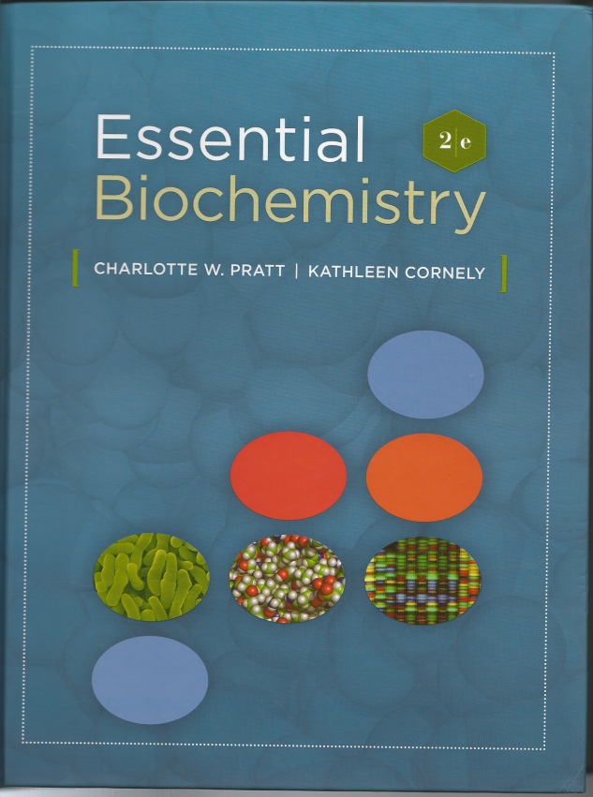
Essential
Biochemistry
Second Edition
Charlotte W. Pratt
Kathleen Cornely

Slide 2
About this Presentation
This presentation was designed to accompany the textbook, “Essential Biochemistry”. However, other than the list of topics, it does not include text or figures from that book. The material in here is all released under a Creative Commons Attribution-ShareAlike 3.0 Unported license. The fonts used here are Linux Libertine O and Linux Biolinium G, which may be freely downloaded from www.linuxlibertine.org. (Also, Liberation Sans is used at one point.)

Slide 3
Chapter 1, The Chemical Basis of Life

Slide 4
Chapter 1: The Chemical Basis of Life
1.1 What is Biochemistry?
1.2 Biological Molecules
1.3 Energy and Metabolism
1.4 The Origin and Evolution of Life

Slide 5
Chapter 1: The Chemical Basis of Life
1.1 What is Biochemistry?
1.2 Biological Molecules
1.3 Energy and Metabolism
1.4 The Origin and Evolution of Life

Slide 6
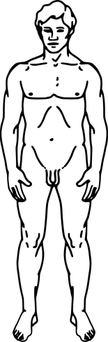
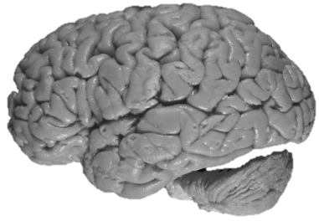
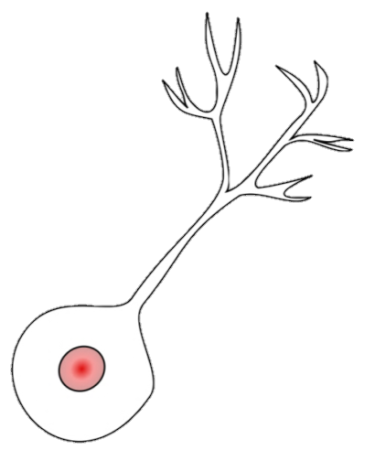
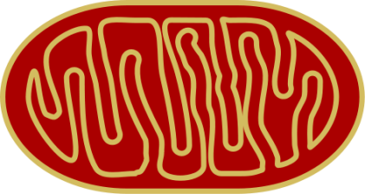
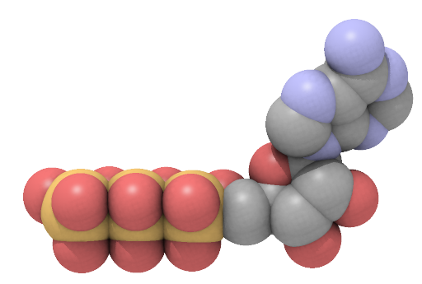
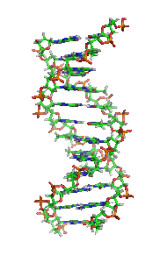
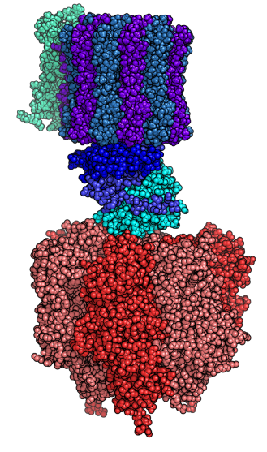
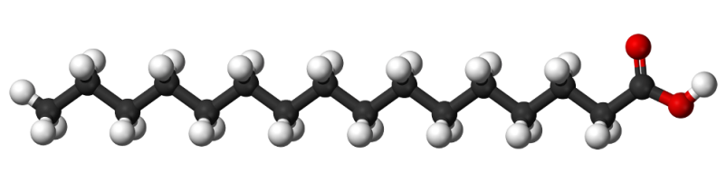
Levels of organization in living organisms
Organism
Organ
Cell
Organelle
brain
neuron
mitochondria
human being
Molecules
ATP
palmitic acid
DNA
ATP synthase
Wikipedia

Slide 7
Chapter 1: The Chemical Basis of Life
1.1 What is Biochemistry?
1.2 Biological Molecules
1.3 Energy and Metabolism
1.4 The Origin and Evolution of Life

Slide 8
Chemical Composition of the
Human Body by Mass
10-100%
1 |  |  |  |  |  |  |  |  |  |  |  |  |  |  |  |  |  |  |  | 18
H | 2 |  |  |  |  |  |  |  |  |  |  |  |  |  | 13 | 14 | 15 | 16 | 17
 |  |  |  |  |  |  |  |  |  |  |  |  |  |  | B | C | N | O | F
Na | Mg |  | 3 |  |  | 4 | 5 | 6 | 7 | 8 | 9 | 10 | 11 | 12 | Al | Si | P | S | Cl
K | Ca |  |  |  |  |  | V | Cr | Mn | Fe | Co | Ni | Cu | Zn |  |  | As | Se | Br
Rb | Sr |  |  |  |  |  |  | Mo |  |  |  |  |  | Cd |  | Sn |  |  | I
Cs | Ba |  |  |  |  |  |  | W |  |  |  | Au |  |  |  | Pb
1-10%
0.1-1%
0.01-0.1%
0.001-0.01%
< 0.001%
Notes:
Source: The CRC, which cites two references:
Padikal, T. N.; Fivozinsky, S. P. Medical Physics Data Book, National Bureau of standards Handbook 138, U. S. Government Printing Office, Washington, DC, 1981.
Snyde, W. S., et al. Reference Man: Anatomical, Physiological, and Metabolic Characteristics, Pergamon, New York, 1975.

Slide 9
Learning Objective:
Identify functional groups that are present in a given biomolecule.

Slide 10
Functional groups common in biochemistry
alcohol
alcohol
OH
hydroxyl group
OH
H
H
C
C
H
R
C
H
H
H
H
ethanol
R: a carbon atom with the other
three substituents being anything.
thiol
“thio”: contains sulfur
SH
sulfhydryl group
R
C
H
H
Notes:
What class of compounds does this belong to?
What’s the name of this specific compound?
Why is the C-H bond shorter?

Slide 11
Functional groups common in biochemistry
aldehyde
ketone
O
carbonyl group
O
acyl group
C
C
R
H
R
R
R: in a molecule with more than one
R group, the R’s may be the same
or different.

Slide 12
Functional groups common in biochemistry
amine
H
H
Under physiological conditions, amines are protonated, and carboxylic acids are deprotonated.
R
N
∶
R
N⁺
H
H
H
H
R
N
∶
R₂NH₂⁺
R
R
R
N
∶
R₃NH⁺
R

Slide 13
Functional groups common in biochemistry
imine
∶
H
N
C
∶
H
∶
R
R
H
N
N
∶
H
R
R
N
R═NH₂⁺
R═NRH⁺
C
R
R

Slide 14
Functional groups common in biochemistry
carboxylic acid
O
C
R
OH
O
carboxylate
C
H₃C
OH
O
acetic acid
C
R
O–
Notes:
Name this acid.

Slide 15
Functional groups common in biochemistry
ester
O
C
H
H
H
R
OR
H
C
C
O
C
H
ether
H
H
H
R
O
R
ethyl methyl ether
amide
O
O
O
C
C
C
R
NH₂
R
NRH
R
NR₂
Notes:
Name this acid.

Slide 16
Functional groups common in biochemistry
phosphoric acid
hydrogen phosphate ion, P_{i}
O
O
HO
P
OH
HO
P
O–
OH
O–
phosphoric acid ester
O
RO
P
O–
phosphoryl group
O–

Slide 17
Functional groups common in biochemistry
O
O
HO
P
OH
+
HO
P
OH
OH
OH
Δ
phosphoanhydride linkage
O
O
O
O
HO
P
O
P
OH
+
H₂O
–O
P
O
P
O–
OH
OH
O–
O–
pyrophosphoric acid
pyrophosphate ion, PP_{i}

Slide 18
Functional groups common in biochemistry
diphosphoric acid ester
O
O
RO
P
O
P
O–
O–
O–

Slide 19
Learning Objective:
Recognize the structures of the four basic biomolecules.
Notes:
Monomers
Amino acids (alanine)
Simple carbohydrates, sketch cyclic structure of sugar,
nucleotides, sketch ATP

Slide 20
Nucleotide
phosphate
(triphosphate)
NH₂
N
nitrogenous
base
(adenine)
N
O
O
O
N
N
O–
P
O
P
O
P
O
CH₂
O
H
H
sugar
(ribose)
O–
O–
O–
H
H
OH
OH
adenosine triphosphate, ATP

Slide 21
Lipids: not very soluble in water; largely hydrocarbon
O
O–
palmitate
CH₃
CH₃
HO
cholesterol
Notes:
carboxylic acid, anion, 16 carbons.
The red emphasizes the polar end.

Slide 22
Learning Objective:
Know what a residue is.

Slide 23
Formation of polymers from monomers
residue
polymer
monomers
Residue: a monomeric unit in a polymer
Notes:
Mention kD, & amu.

Slide 24
Functions of biopolymers
information
energy & structure
catalyst
polymer
The polymer has a direction.
Notes:
Mention kD, & amu.

Slide 25
Learning Objective:
Describe the three major kinds of biological polymers.

Slide 26
The three kinds of biological polymers
polymer
monomers
amino acids
catalyst
proteins
Notes:
Mention kD, & amu.

Slide 27
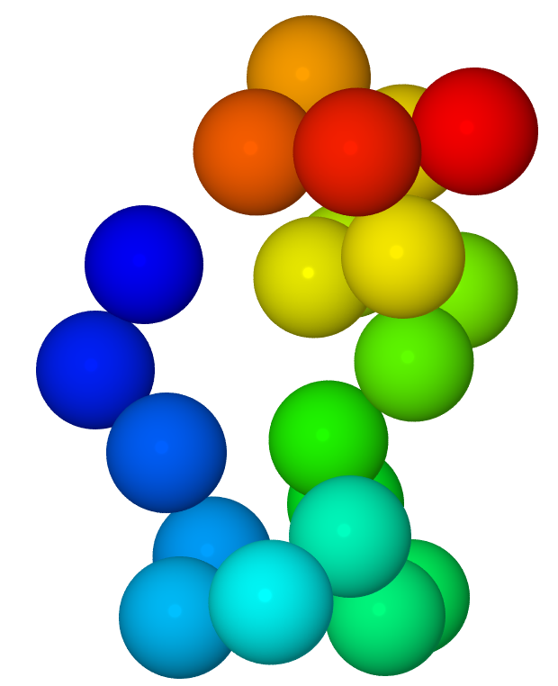
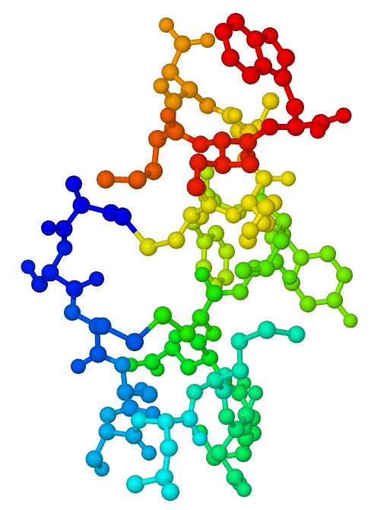
Structure of human endothelin
Notes:
Endothelins are proteins that constrict blood vessels and raise blood pressure.
21 amino acids
Jmol version, 1EDN.pdb, is available
What’s with the color?

Slide 28
The three kinds of biological polymers
polymer
monomers
amino acids
catalyst
proteins
nucleotides
information
nucleic acids
Notes:
Mention kD, & amu.

Slide 29
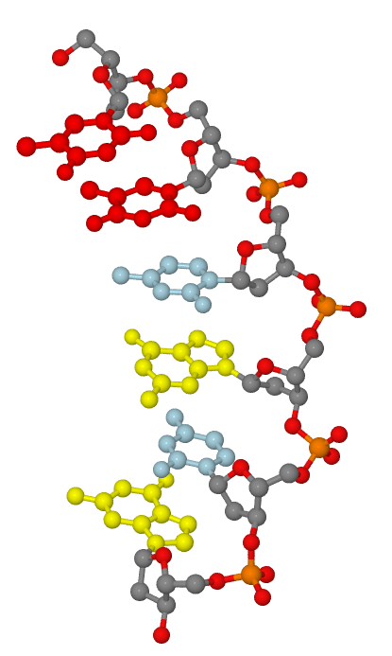
Structure of the nucleic acid UUCGCG
Notes:
Part of a strand of DNA.

Slide 30
The three kinds of biological polymers
polymer
monomers
amino acids
catalyst
proteins
nucleotides
information
nucleic acids
sugars (monosaccharides)
polysaccharides
energy & structure
Notes:
Mention kD, & amu.

Slide 31
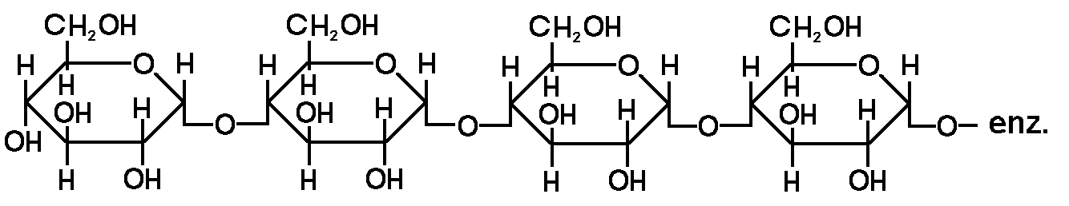
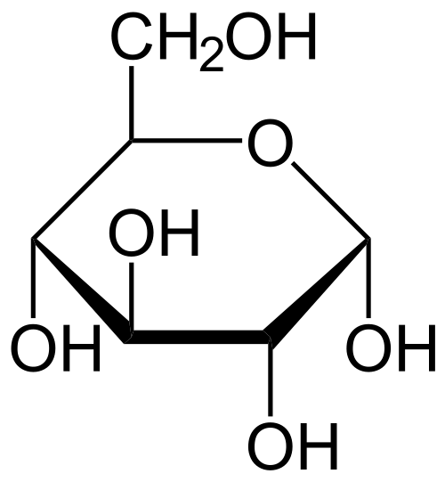
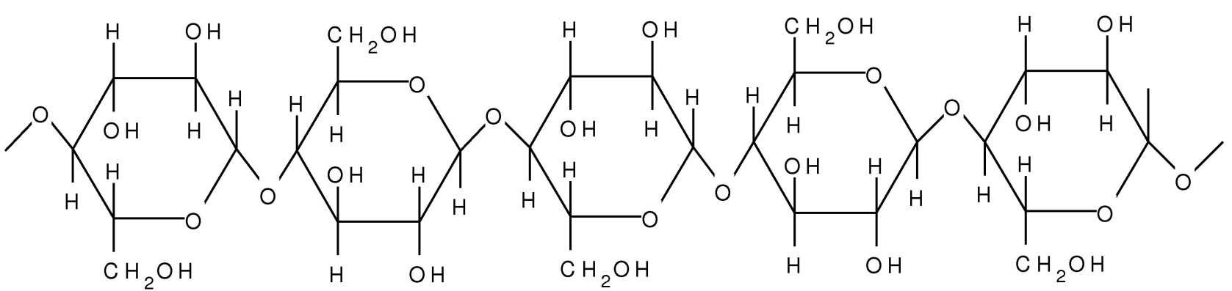
Polysaccharides
starch
glucose
cellulose
Alpha-D-Glucopyranose.svg, Amylose.png & HaworthStrukturCellulose.jpg
Notes:
The red is oxygen.

Slide 32
Chapter 1: The Chemical Basis of Life
1.1 What is Biochemistry?
1.2 Biological Molecules
1.3 Energy and Metabolism
1.4 The Origin and Evolution of Life

Slide 33
Learning Objective:
Determine the oxidation state of an atom in a compound.

Slide 34
Reduction and reoxidation of carbon compounds
light
energy
free
energy
O = C = O
H C OH
O = C = O
reduction;
unfavorable
oxidation;
favorable
carbon in a
monosaccharide

Slide 35
Oxidation states of carbon
Most oxidized
carbon dioxide
O
H
H
O
C
O
acetaldehyde
O
C
ethene
C
C
acetic acid
H₃C
H
C
H
H
H₃C
OH
O
formaldehyde
H
H
carbon monoxide
C
ethane
C
O
H
H
H
C
C
H
O
H
H
acetylene
formic acid
C
H
C
C
H
H
H
OH
H
OH
methane
ethanol
O
H
C
H
acetone
H
C
C
H
H
C
H
H
H₃C
CH₃
Most reduced
Notes:
Count the charge on C for each bond
Electronegativity: H < C < O
Just look at the bonds (since C is uncharged)
Or: O is 2-, H is +, and sum of charges = charge on species.

Slide 36
Oxidation states of carbon
Most oxidized
H
OH
ethanol
carbon dioxide
O
H
C
C
H
O
C
O
acetone
C
H
H
O
H₃C
CH₃
acetic acid
H
H
C
O
ethene
H₃C
OH
C
C
acetaldehyde
C
H
H
carbon monoxide
H₃C
H
C
O
ethane
H
H
O
O
formaldehyde
H
C
C
H
formic acid
C
H
H
C
H
H
H
OH
acetylene
methane
H
H
C
C
H
H
C
H
H
Most reduced
Notes:
Count the charge on C for each bond
Electronegativity: H < C < O
Just look at the bonds (since C is uncharged)
Or: O is 2-, H is +, and sum of charges = charge on species.

Slide 37
Reduction and reoxidation of carbon compounds
light
energy
free
energy
O = C = O
H C OH
O = C = O
reduction;
unfavorable
oxidation;
favorable
carbon in a
monosaccharide
Notes:
Oil Rig
(This figure uses the font Liberation Sans.)

Slide 38
Learning Objective:
Recognize whether entropy increases or decreases for a given change.
Notes:
Temperature, volume, number of particles

Slide 39
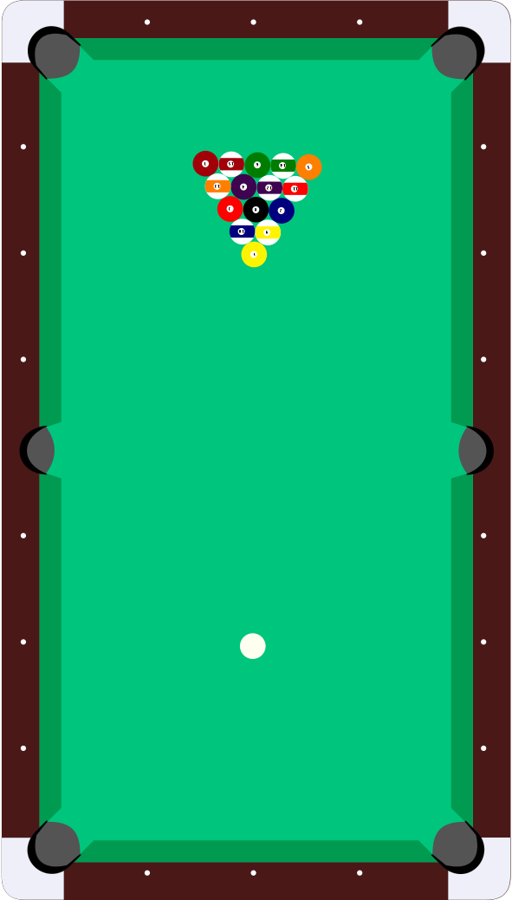
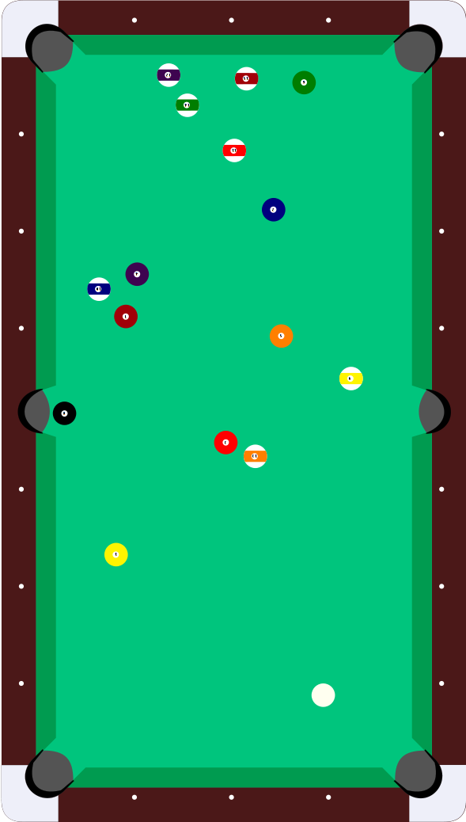
Entropy: number of arrangements
open clip art library
Notes:
[End of lecture]

Slide 40
Learning Objective:
Understand the meanings of enthalpy, entropy, and free energy and how they are related.

Slide 41
Learning Objective:
Predict whether a process will be spontaneous or not using the change in free energy, ΔG, given by ΔG = ΔH – TΔS.

Slide 42
Sample Calculation 1-1
Calculate the free energy change for the reaction A → B at 25°C using the information below. Does this reaction occur spontaneously?
 | Enthalpy/ (kJ/mol) | Entropy / (J/(mol∙K))
A | 70 | 33
B | 85 | 108
ΔG° = -7.35 kJ/mol
Notes:
ΔG° = 15 kJ/mol – 0.075 kJ/(mol K) × 298 K

Slide 43
Reduction and reoxidation of carbon compounds
light
energy
free
energy
O = C = O
H C OH
O = C = O
reduction;
unfavorable
oxidation;
favorable
carbon in a
monosaccharide

Slide 44
Chapter 1: The Chemical Basis of Life
1.1 What is Biochemistry?
1.2 Biological Molecules
1.3 Energy and Metabolism
1.4 The Origin and Evolution of Life

Slide 45
Learning Objective:
Describe the differences between prokaryotes and eukaryotes.
Notes:
These are kinds of cells
Cells: natural selection would favor, since keeps chemicals together
The first cells may have “fixed” CO₂—reduced it to organic compounds—using H₂S and Fe²⁺.
Vestiges of these processes can be seen in current organisms in reactions involving S and Fe.

Slide 46
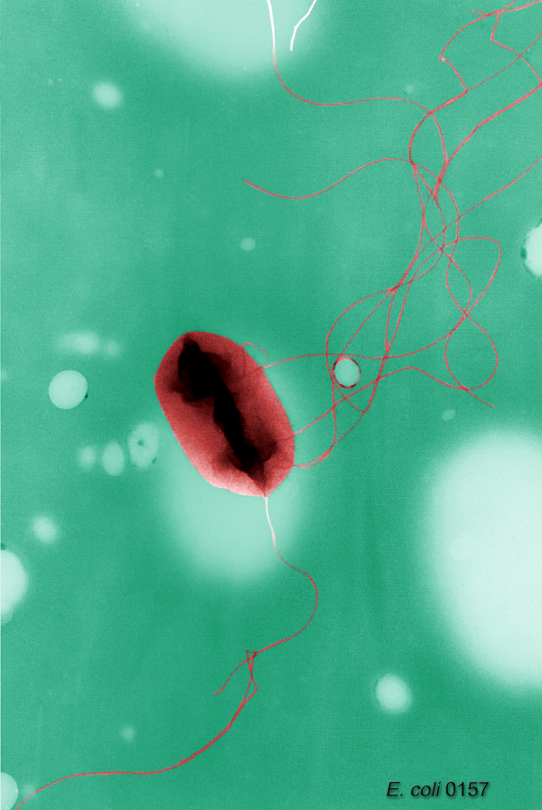
Prokaryotic cells: Escherichia coli
Prokaryotes: small unicellular
organisms that lack a
discrete nucleus and
internal membranes.
E.g.: Bacteria, such as
E. coli, and archaea,
found in extreme
environments.
Public Health Image Library
Notes:
CDC: Public Health Image Library ID# 9995, & 10068
Colorized SEM.
Prokaryotes: small unicellular organisms that lack a discrete nucleus and internal membranes
Bacteria, such as E. coli, and archaea (extreme environments)
Note the size, about 2 µm.

Slide 47
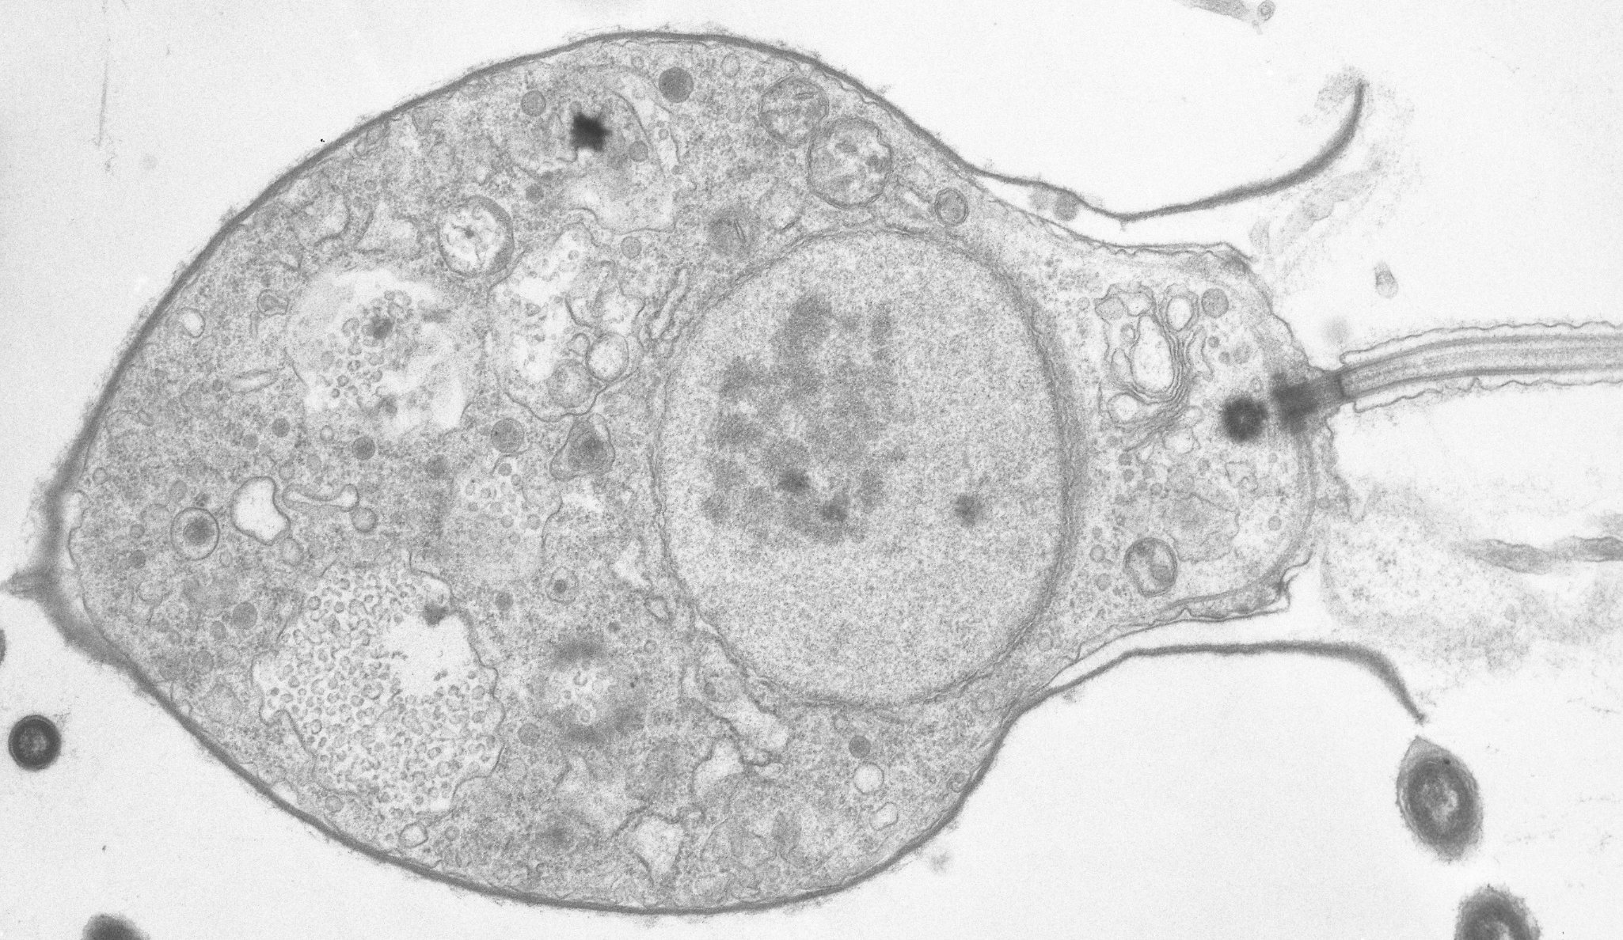
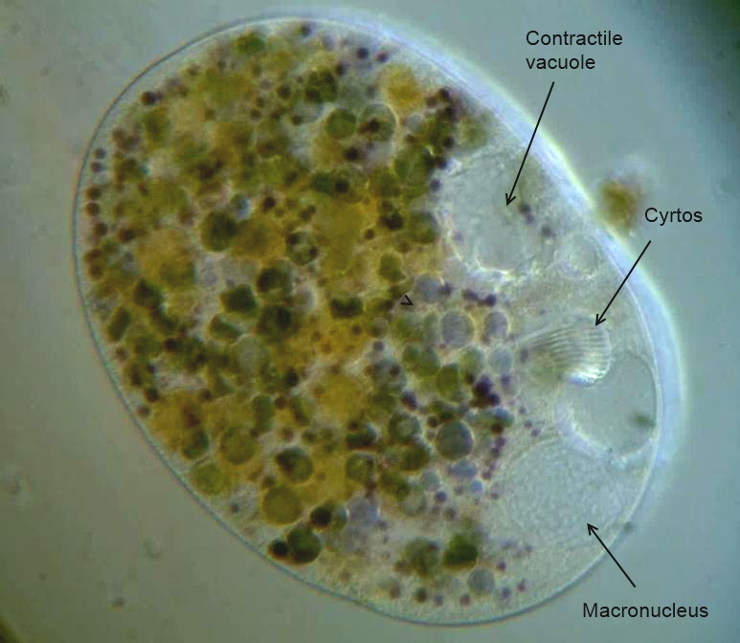
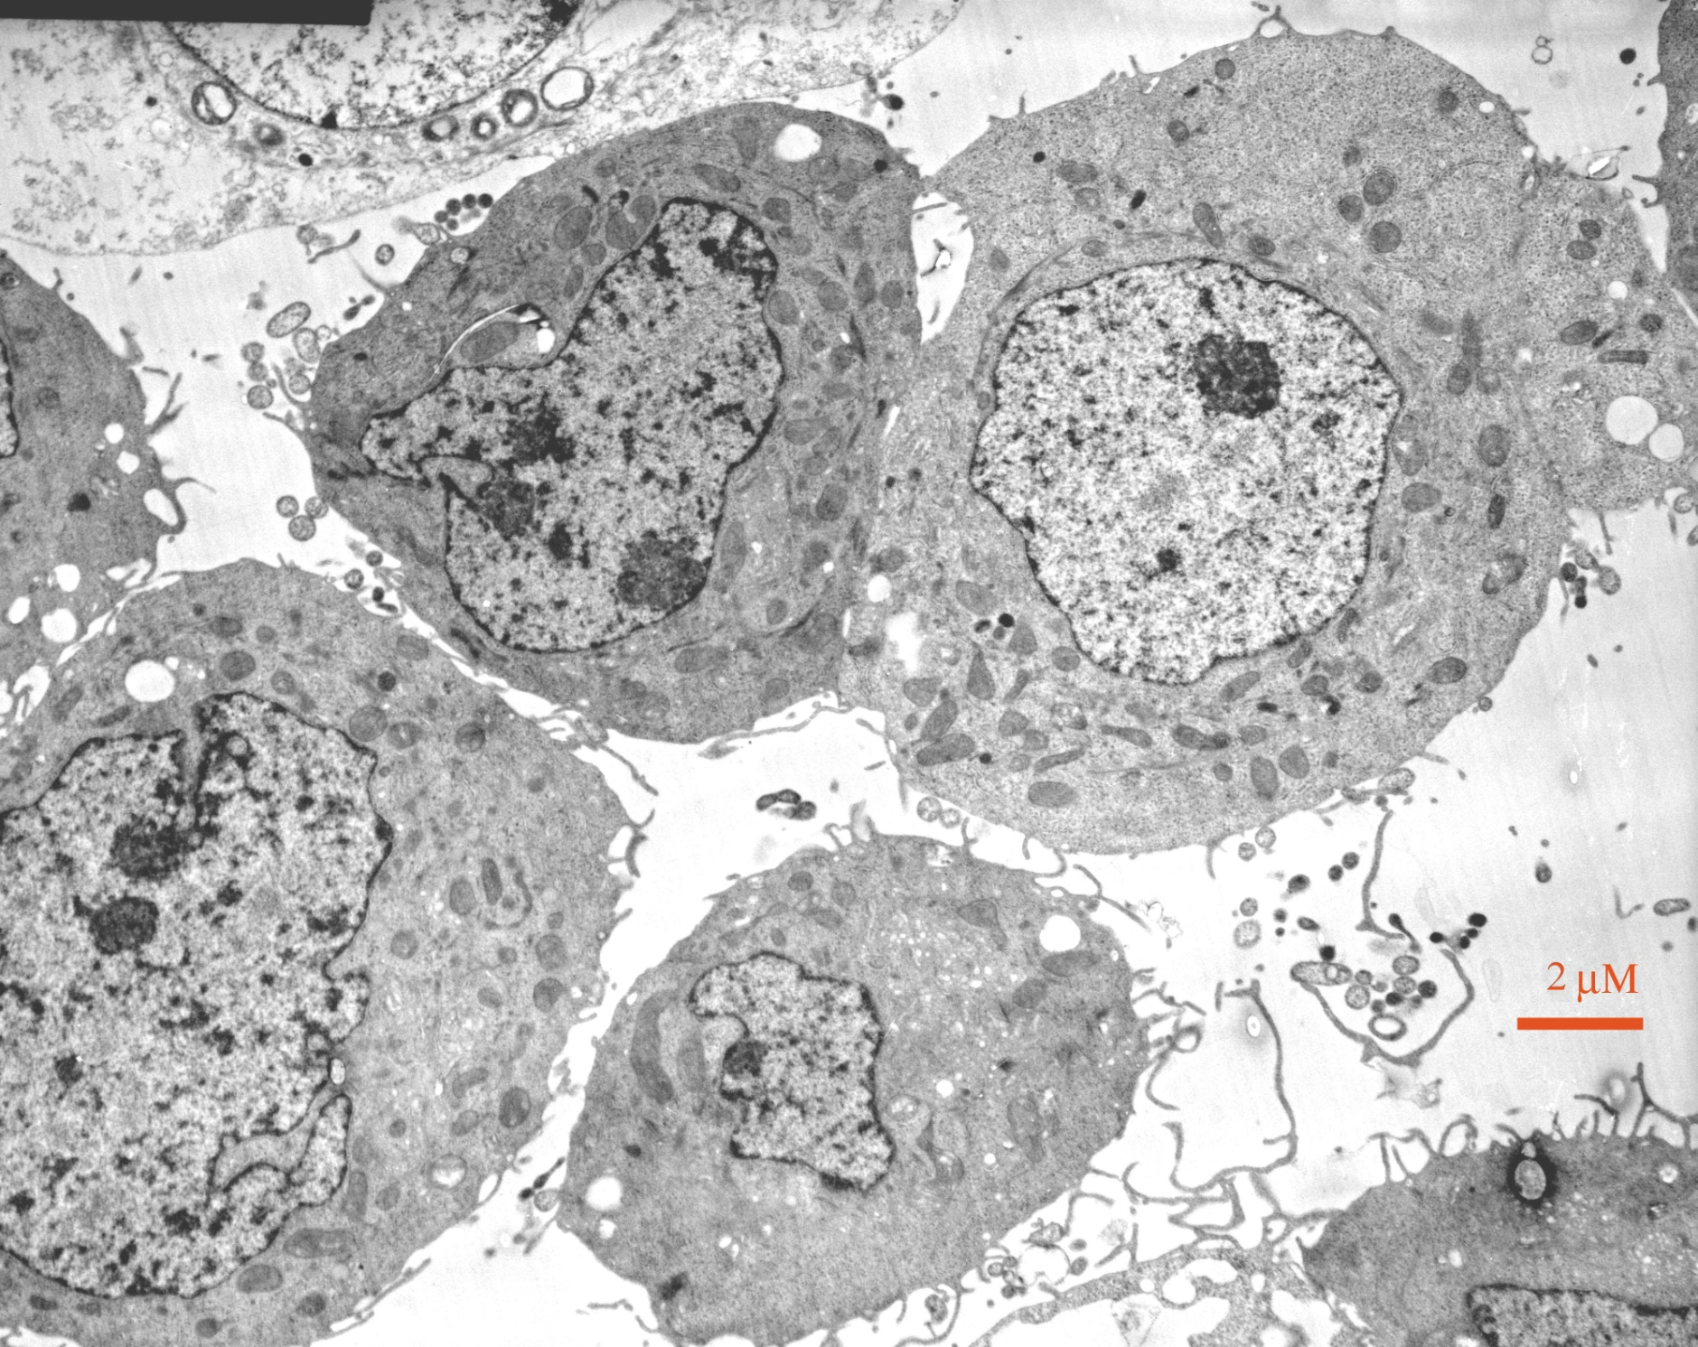
A eukaryotic cell
Wikipedia Salpingoeca sp.jpg
Notes:
TEM of Salpingoeca sp., and (multiple cells) Electron microscopy.jpg (no details). Also, in color, Nassula.jpg.
Eukaryotes: usually larger cells with a nucleus and membrane-bound cellular compartments. May be multicellular.
Which came first, and how tell?

Slide 48
Learning Objective:
Suggest how eukaryotes may have formed.
Notes:
(“Metabolism first”)

Slide 49
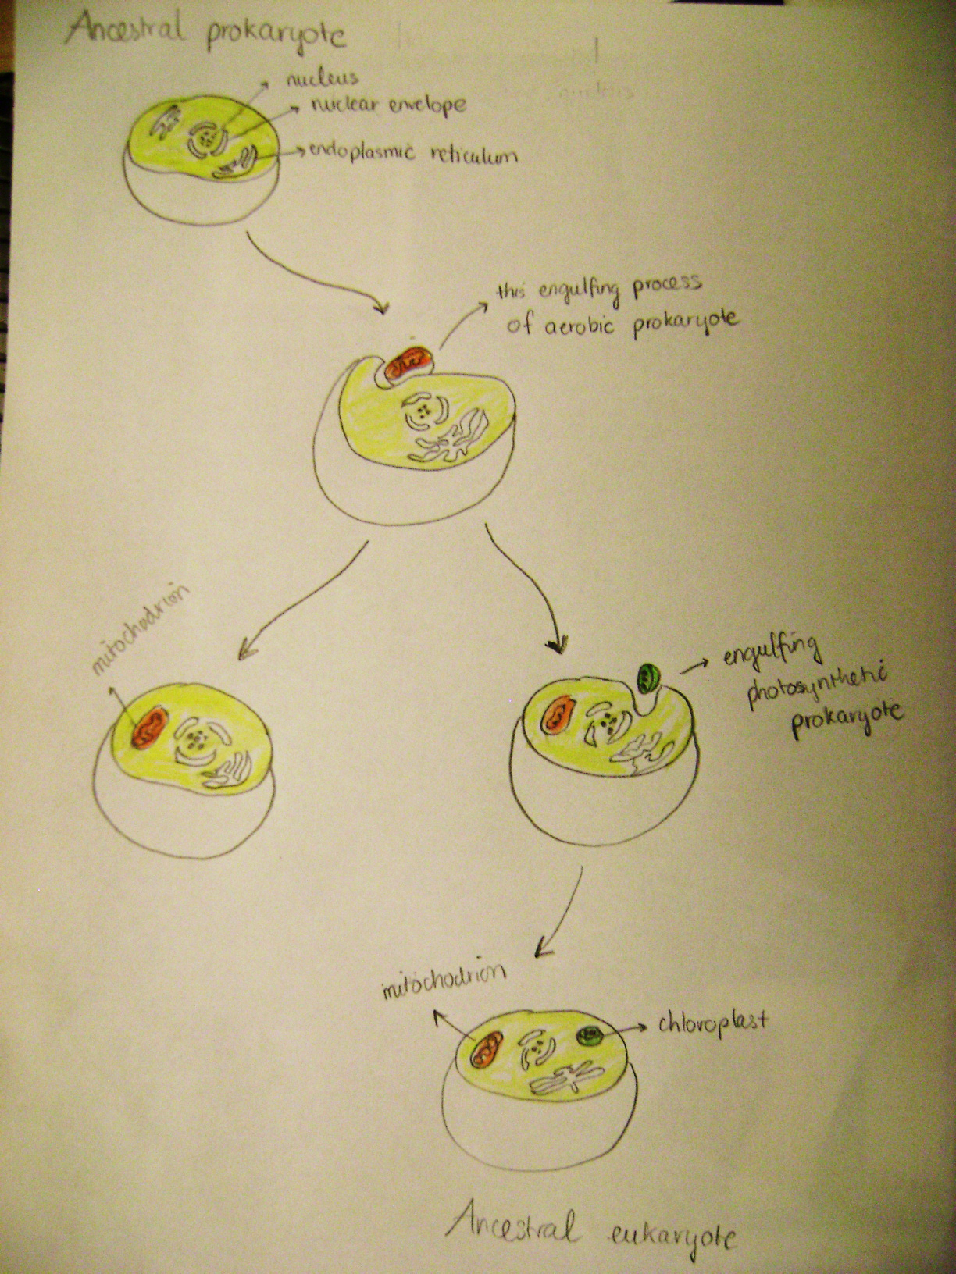
Possible origin of eukaryotic cells
(endosymbiotic theory)
ancestral prokaryote
nucleus
nuclear envelope
endoplasmic reticulum
engulfing a
photosynthetic
prokaryote
engulfing an
aerobic prokaryote
chloroplast
mitochondrion
mitochondrion
ancestral eukaryote
Wikipedia: Engulfing_of_prokayote.JPG
Notes:
(Don’t need to know the term, “endosymbiotic”)

Slide 50
Learning Objective:
Give evidence that suggests that a phylogenetic tree should have one trunk.
Notes:
(“Metabolism first”)

Slide 51
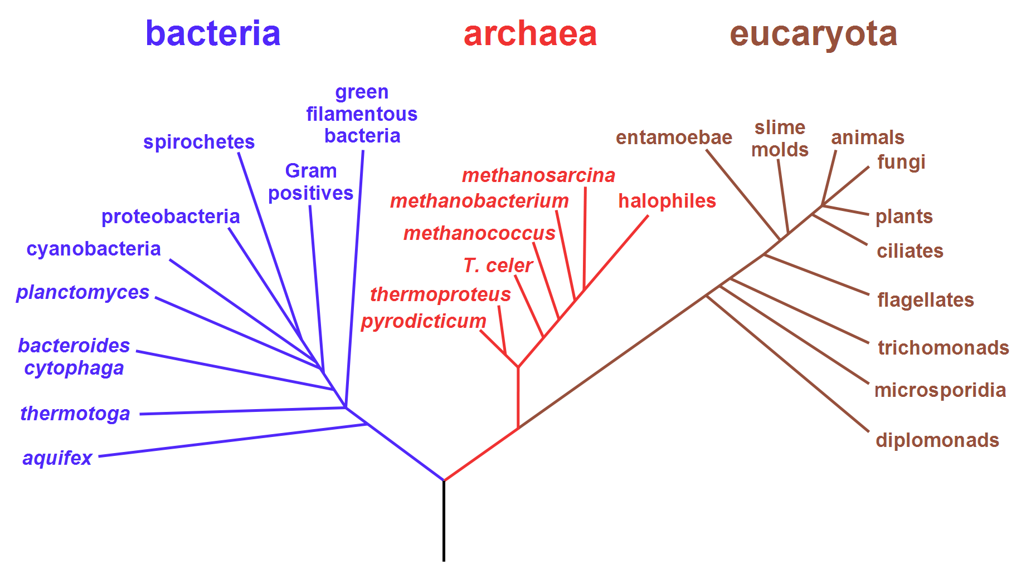
Phylogenetic Tree of Life
prokaryota
Wikipedia: Phylogenetic_tree.svg
Notes:
Note the single trunk of the tree…

Slide 52
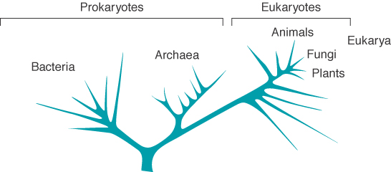
Evolutionary tree based on nucleotide sequences
Figure 1.15
Notes:
(This is from their textbook. It makes no sense, and should be lines. It is included just for comparison to the correct way, on the previous slide.)

Slide 53
Evidence for a common ancestor
Nucleic acids—DNA and RNA—participate in the storage and transmission of genetic information in all organisms.
Oxidation of glucose is an almost universal means for generating metabolic free energy.
pp. 15-16

Slide 54
Learning Objective:
Describe the Miller-Urey experiment, and its significance.
Notes:
(“Metabolism first”)

Slide 55
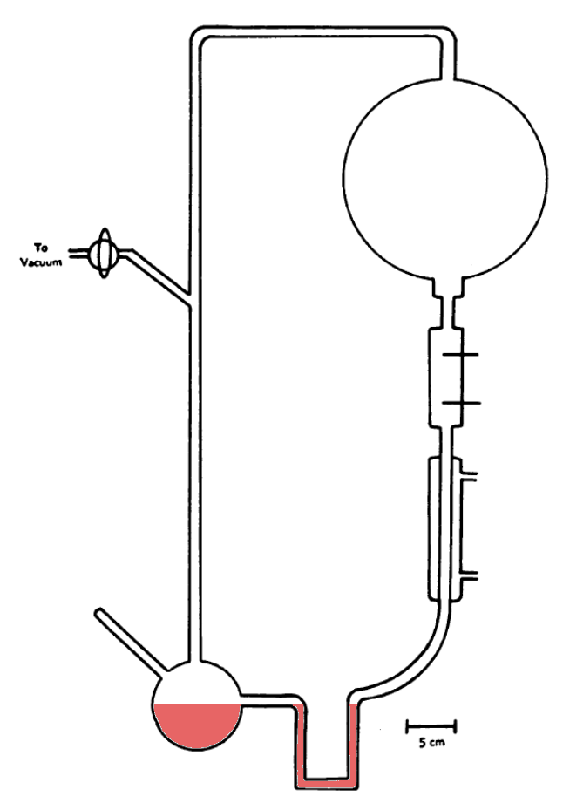
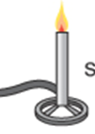
Laboratory synthesis of amino acids
H₂, H₂O,
NH₃, and CH₄
to gas line
electrodes
condenser
5cm
After Miller

Slide 56
Synthesis of acetic acid
FeS, NiS
CH₃SH + CO + H₂O acetic acid + H₂S
100°C
Notes:
Black smokers, up to 350°C.
H₂S, metal sulfides.
Form a C-C bond

Slide 57
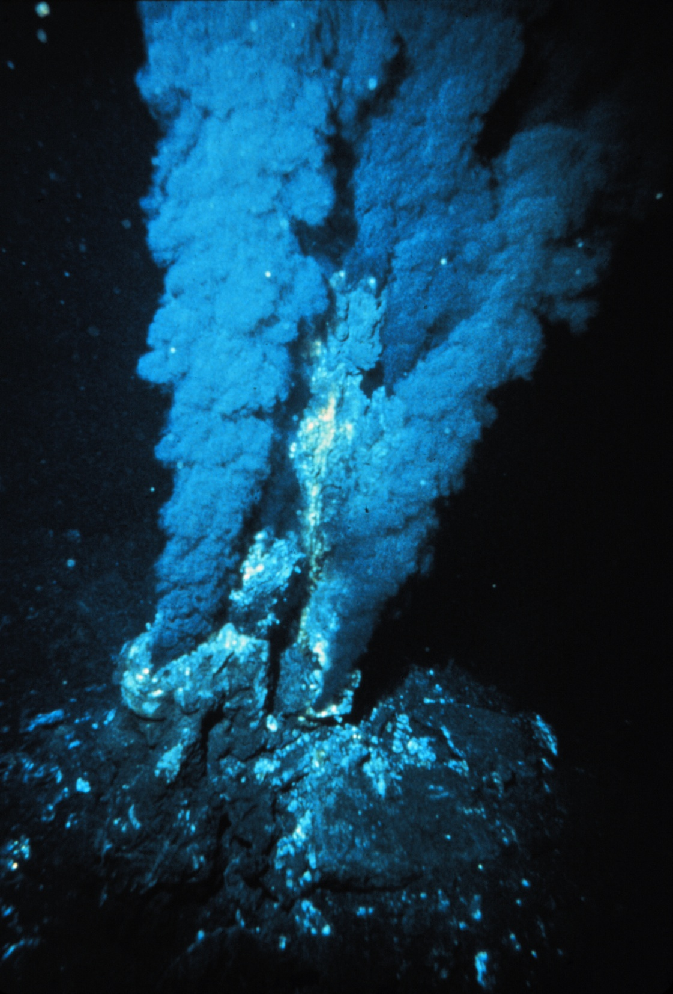
Blacksmoker in the
Atlantic Ocean
Wikipedia
Notes:
A hydrothermal vent
Black smokers, up to 350°C.
H2S, metal sulfides.

Slide 58
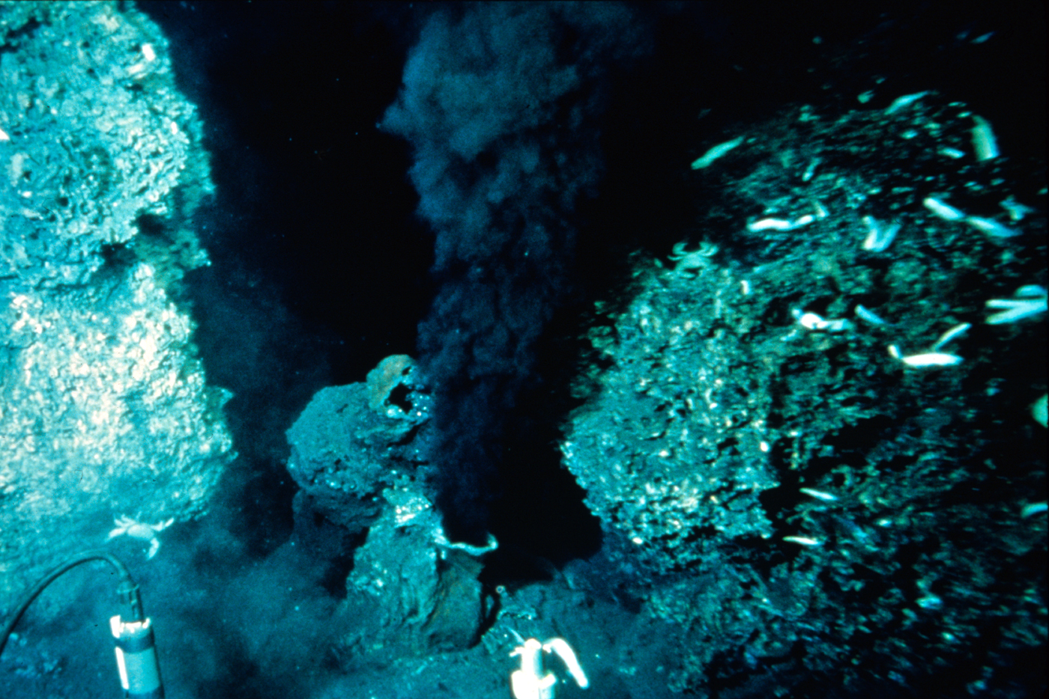
Black Smoker in the Pacific Ocean
Wikipedia: BlackSmoker.jpg

Slide 59

Possible mechanism for replication of a primitive
RNA molecule on clay
U
U
A
U
A
A
U
A
A
U
A
A
A
A
U
U
A
A
A
A
U
U
A
A
A
U
U
A
A
U
U
A
A
U
U
A
A
U
A
A
U
A
U
A
A
U
U
A
A
U
U
A
A
U
A
A
U
A
A
U
Notes:
Replication (seems to) require polymerization
Clay catalyzes polymerization of nucleotides into RNA.
Clay is sedimentary material that is smaller than 0.002 mm (the particles are not visible to the naked eye).

Slide 60
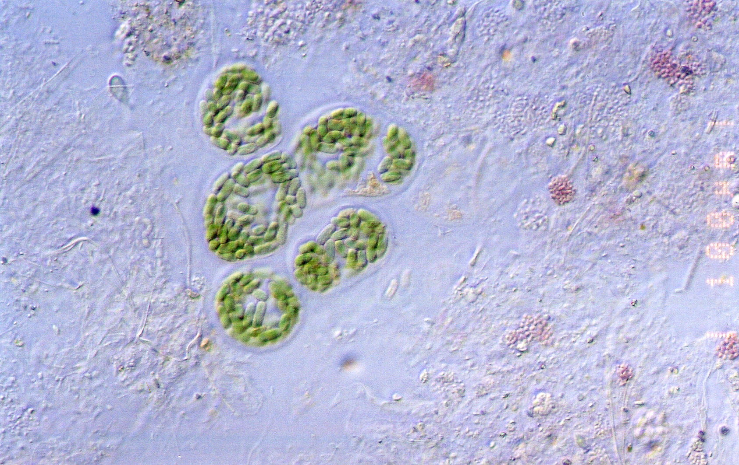
Cyanobacteria
Cyanobacteria guerrero negro.jpg
Notes:
Unicellular bacteria from a microbial mat in Guerrero Negro, Baja California, Mexico.
The cells are in a common “sheath”
Photosynthetic organisms developed later.
CO₂ + H₂O → (CH₂O)_{n} + O₂
Changed the atmosphere.
Aerobic (require oxygen) and anaerobic organisms

